Slide 1

Customer Shopping Behavior Analysis
Understanding purchasing patterns, demographics, and revenue drivers through data analytics

Slide 2

Dataset Overview
3,900
12
3
Transaction Records
Key Attributes
Analysis Phases
Demographics, purchases, ratings
Python, SQL, Power BI
Customer purchases analyzed

Slide 3
Data Preparation Workflow
01
02
03
Data Loading
Data Cleaning
Standardization
CSV imported into Pandas for processing
Missing ratings handled with category-wise median
Column names normalized (lowercase, underscores)
04
05
Feature Engineering
Optimization
Created age_group and purchase_frequency_days
Removed redundant promo_code_used column

Slide 4
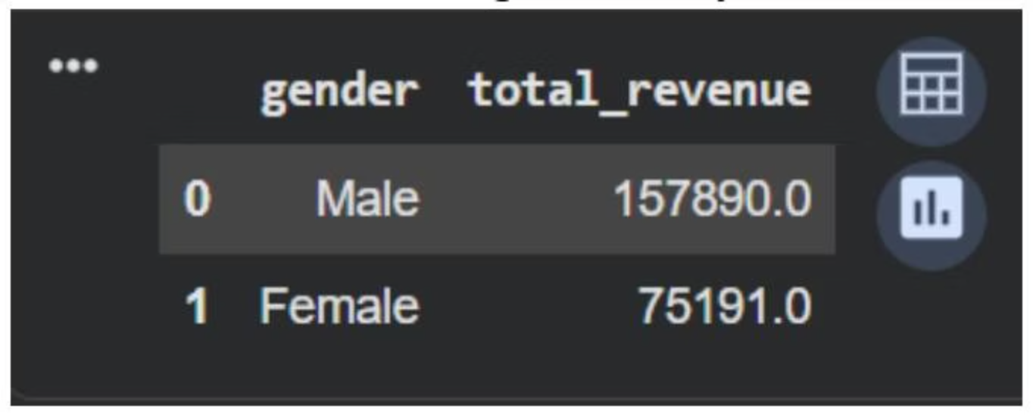
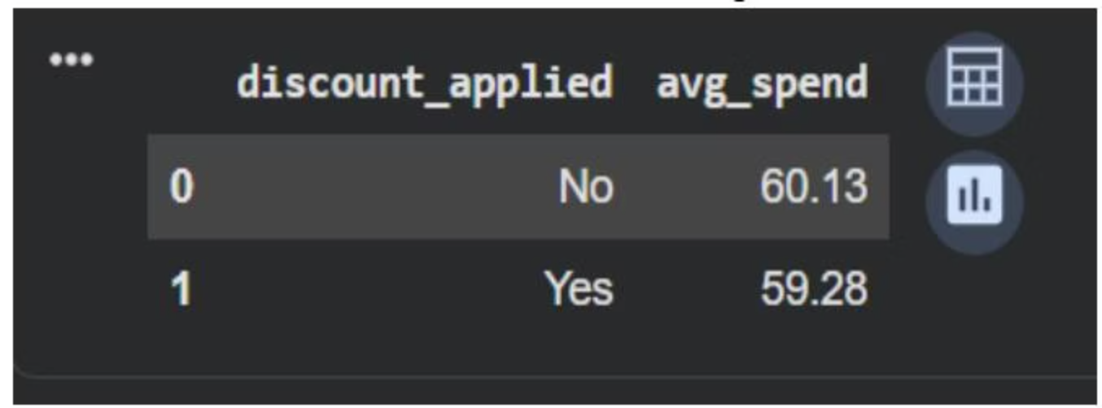
Revenue by Gender & Discount Impact
Male vs Female Revenue
Discount Usage Analysis
Discounts don't significantly increase average spend
Male customers drive significantly higher total revenue

Slide 5
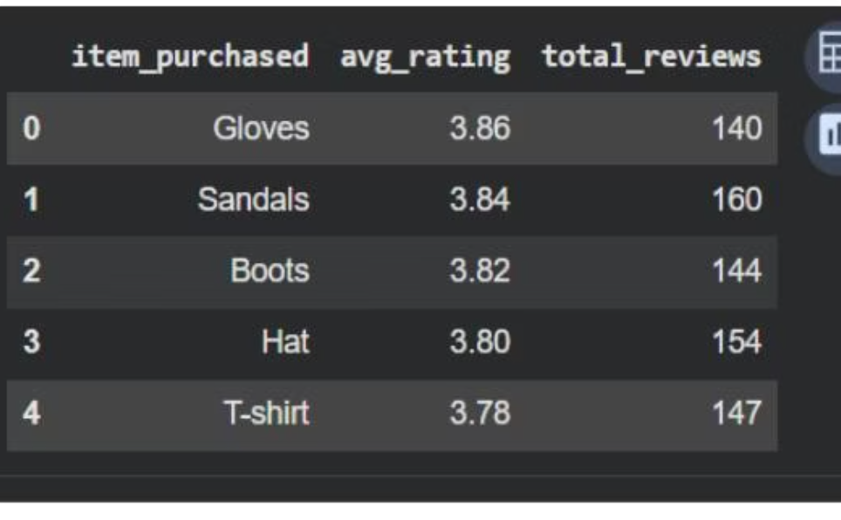
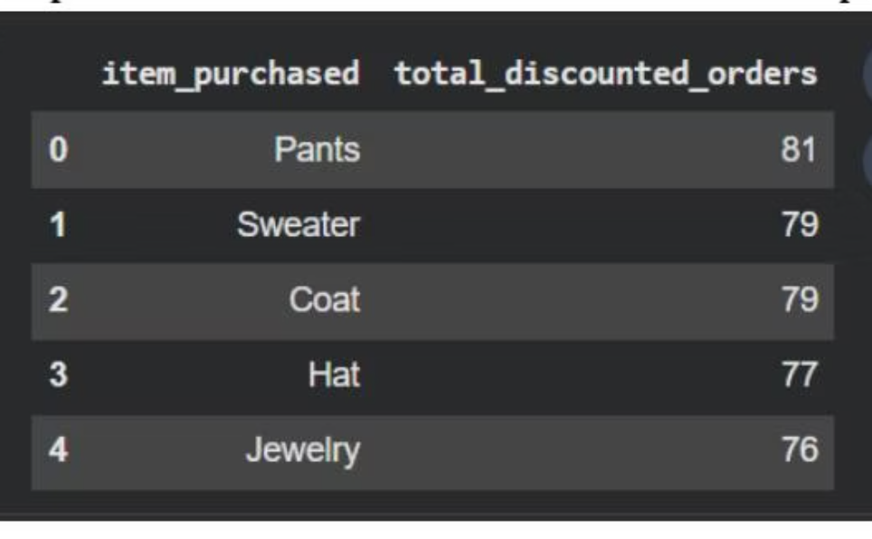
Product Performance Insights
Top-Rated Products
Most Discounted Items
Highest average review ratings across categories
Products receiving highest discount frequency

Slide 6
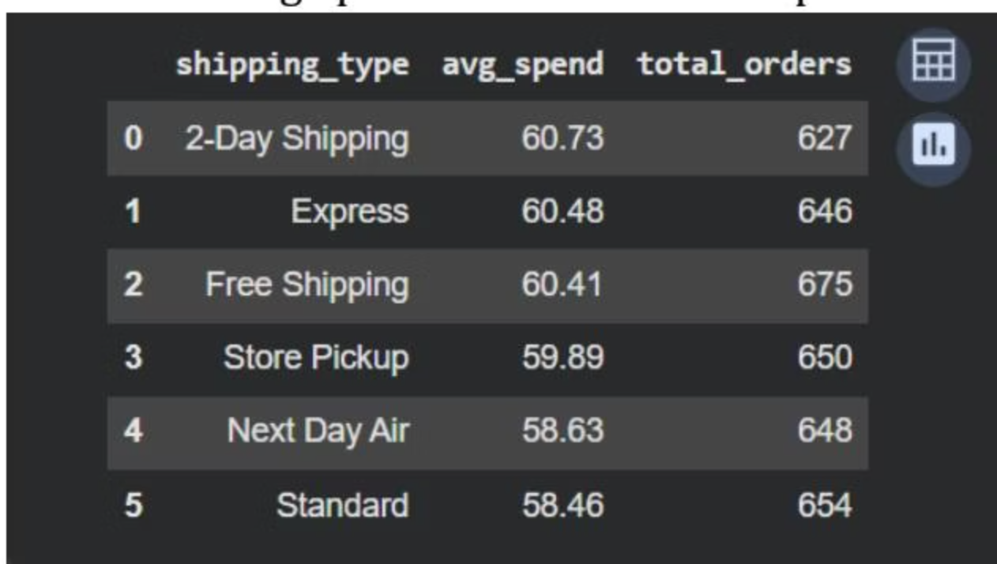
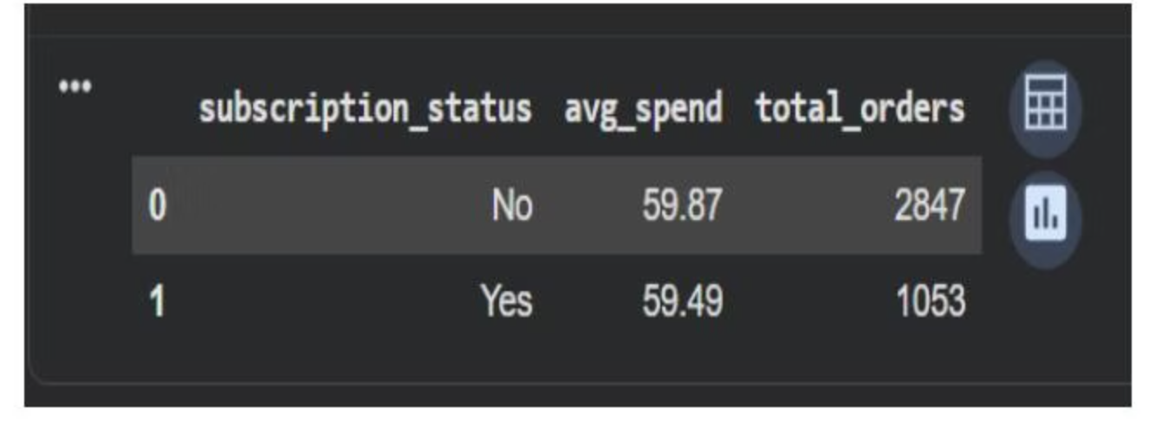
Shipping & Subscription Analysis
Shipping Type Comparison
Subscription Impact
Subscribed customers show different spending patterns
Average purchase amounts vary by delivery method

Slide 7
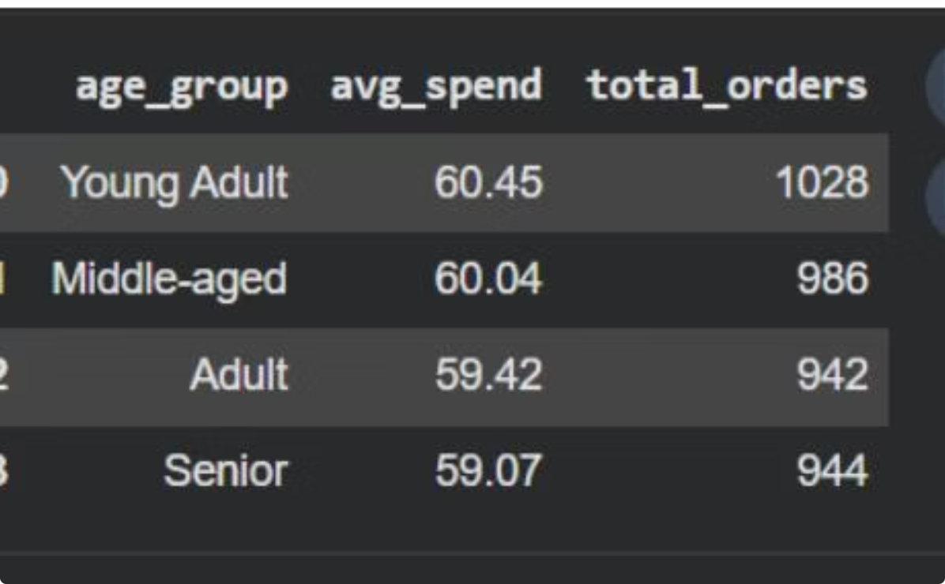
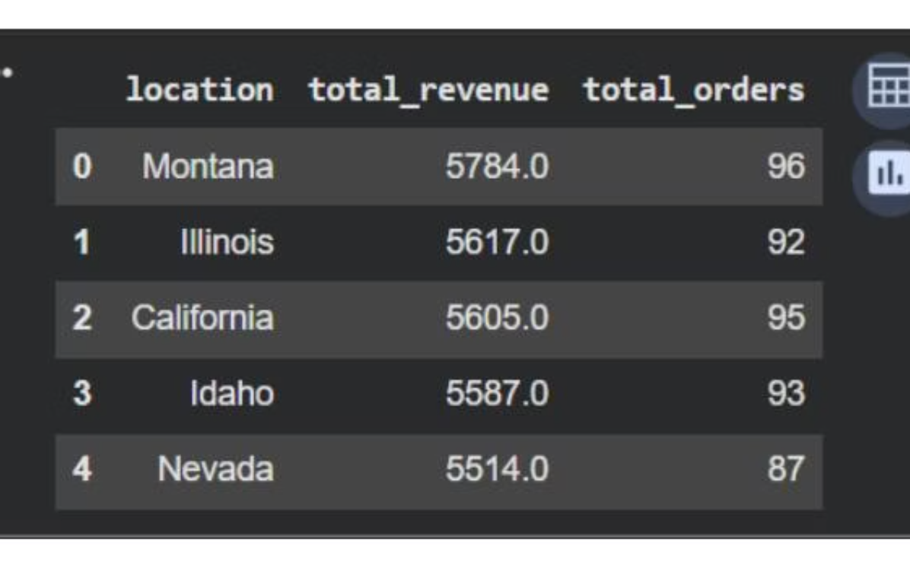
Revenue Drivers by Demographics
Age Group Revenue
Location Performance
Identifying highest-contributing age segments
Top revenue-generating geographic areas

Slide 8
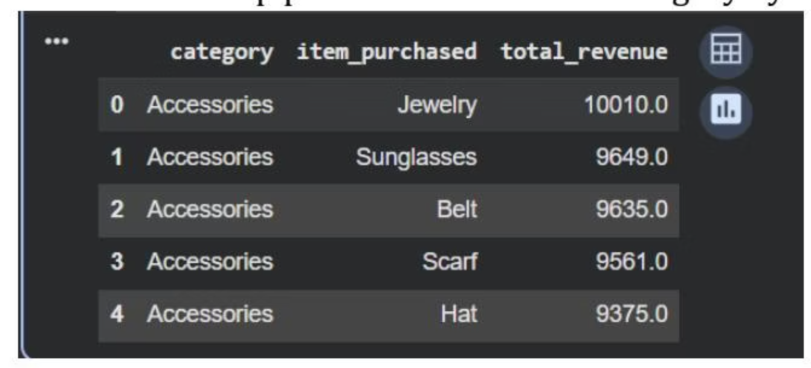
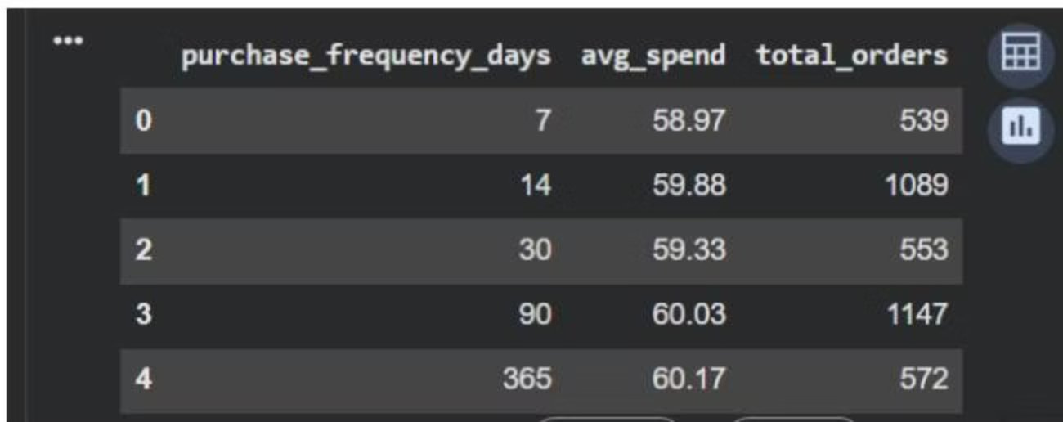
Category & Frequency Insights
Purchase Frequency Effect
Top Products by Category
How buying frequency impacts average spend
Revenue leaders within each product category

Slide 9
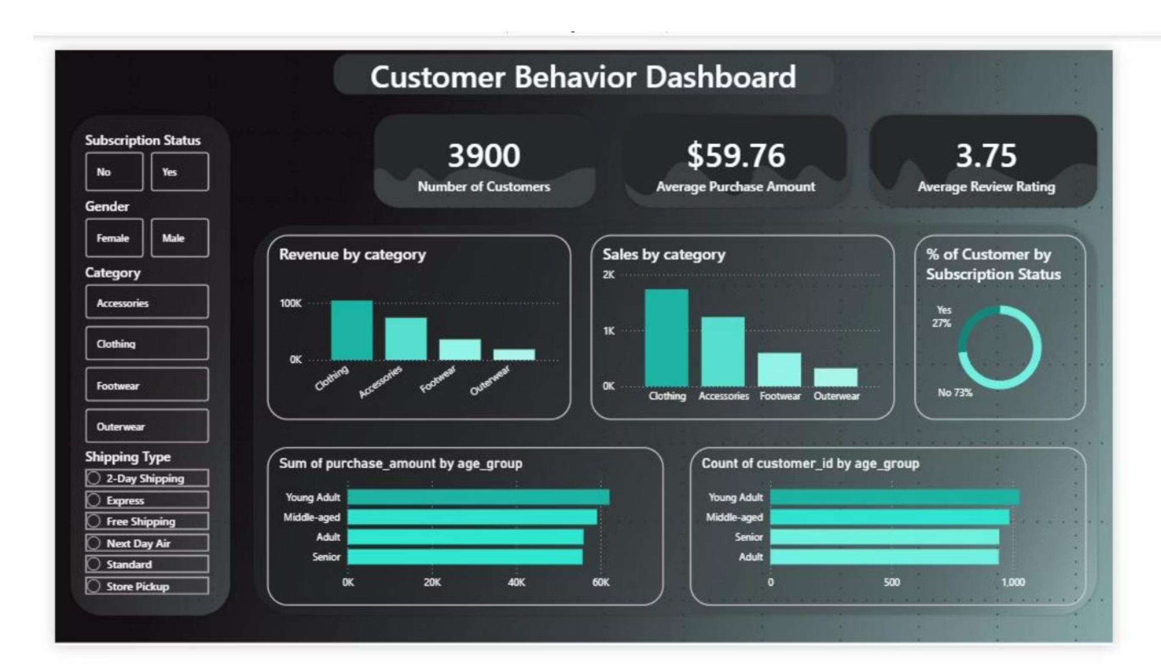
Interactive Power BI Dashboard
Dynamic visualization with KPIs, category revenue, demographics, and subscription analysis

Slide 10

Strategic Recommendations
Focus High-Revenue Categories
Close Gender Gap
Strategic Discounting
Targeted campaigns for female customers to balance revenue
Use discounts selectively rather than broadly
Prioritize Clothing and Accessories marketing for maximum ROI
Optimize Shipping
Monitor Trends
Improve cost efficiency for high-volume delivery methods
Use dashboards regularly to adjust strategies proactively

